Slide 1
Parsing Natural Scenes and Natural Language with Recursive Neural Networks
Richard Socher
Cliff Chiung-Yu Lin
Andrew Y. Ng
Christopher D. Manning
Computer Science Department, Stanford University

Slide 2
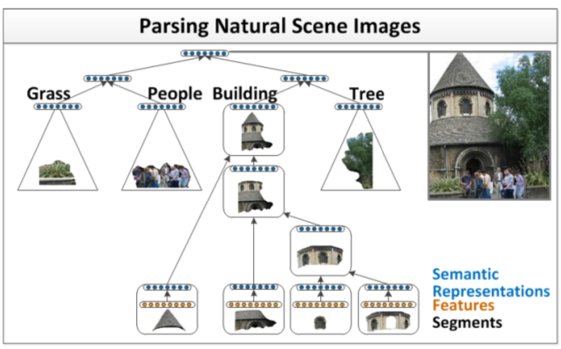
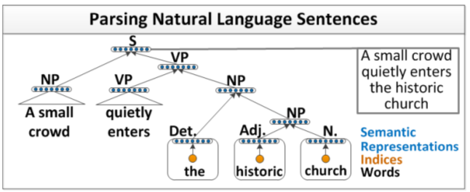
Motivation for the Paper
The Paper aims to identify the Recursive Structure for that is present in images and Sentences and aims to use that for further annotation of images and their classification. We use a Recurrent Neural Network for finding the recursive structure.
Fig.2 Recursive Structure in Sentences
Fig.1 Recursive Structure in Images

Slide 3
Algorithm Flow
Each image divided into 78 Segments 119
Features such as
color and texture features , boosted pixel classifier
scores (trained on the
labeled training data),
as well as appearance and shape features.
After that an Adjacency matrix is
made based on the segment locations
Images

